Slide 1

Management
Fourteenth Edition
Chapter 18A
Planning and Control Techniques Module
Copyright © 2018, 2016, 2014 Pearson Education, Inc. All Rights Reserved

Slide 2
Environmental Scanning
The goal is to detect emerging trends, to anticipate and interpret changes in the environment.
Competitor intelligence is gathering information about their competitors.
Managers have expanded their scope to gain vital information on global forces that might affect their organizations.
Notes:
As we discussed in Chapter 8, environmental scanning is an important element of the strategic planning process. The goal is to detect emerging trends, the screening of large amounts of information to anticipate and interpret changes in the environment. Research has shown that companies that use environmental scanning have higher performance. Organizations that don’t keep on top of environmental changes are likely to experience the opposite!
There are two fast-growing areas of environmental scanning: competitor intelligence and global scanning. As we discussed in Chapter 8, competitor intelligence is a process by which organizations gather information about their competitors and get answers to questions such as Who are they? What are they doing? How will what they’re doing affect us?
Global scanning is another type of environmental scanning that’s particularly important. Because world markets are complex and dynamic, managers have expanded the scope of their scanning e orts to gain vital information on global forces that might affect their organizations.

Slide 3
Forecasting
Forecasts: predictions of outcome
Quantitative forecasting: forecasting that applies a set of mathematical rules to a series of past data to predict outcomes
Qualitative forecasting: forecasting that uses the judgment and opinions of knowledgeable individuals to predict outcomes
Notes:
Forecasting is an important part of planning, and managers need forecasts that will allow them to predict future events effectively and in a timely manner.

Slide 4
Exhibit PC-1: Forecasting Techniques: Quantitative
Technique | Description | Application
Time series analysis | Fits a trend line to a mathematical equation and projects into the future by means of this equation | Predicting next quarter’s sales on the basis of four years of previous sales data
Regression models | Predicts one variable on the basis of known or assumed other variables | Seeking factors that will predict a certain level of sales (e.g., price, advertising expenditures)
Econometric models | Uses a set of regression equations to simulate segments of the economy | Predicting change in car sales as a result of changes in tax laws
Economic indicators | Uses one or more economic indicators to predict a future state of the economy | Using change in GNP to predict discretionary income
Substitution effect | Uses a mathematical formula to predict how, when, and under what circumstances a new product or technology will replace an existing one | Predicting the effect of streaming video services on the sale of Blu-ray players
Notes:
Exhibit PC-1 describes some popular forecasting techniques.

Slide 5
Exhibit PC-1 Forecasting Techniques: Qualitative
Technique | Description | Application
Jury of opinion | Combines and averages the opinions of experts | Polling the company’s human resource managers to predict next year’s college recruitment needs
Sales force composition | Combines estimates from field sales personnel of customers’ expected purchases | Predicting next year’s sales of industrial lasers
Customer evaluation | Combines estimates from established customers’ purchases | Surveying major car dealers by a car manufacturer to determine types and quantities of products desired
Notes:
Exhibit PC-1 describes some popular forecasting techniques.

Slide 6
Benchmarking
Benchmarking: the search for the best practices among competitors or noncompetitors that lead to their superior performance
Notes:
The basic idea behind benchmarking is that managers can improve performance by analyzing and then copying the methods of the leaders in various fields. Organizations such as Nissan, Payless Shoe Source, the U.S. military, General Mills, United Airlines, and Volvo Construction Equipment have used benchmarking as a tool in improving performance.

Slide 7
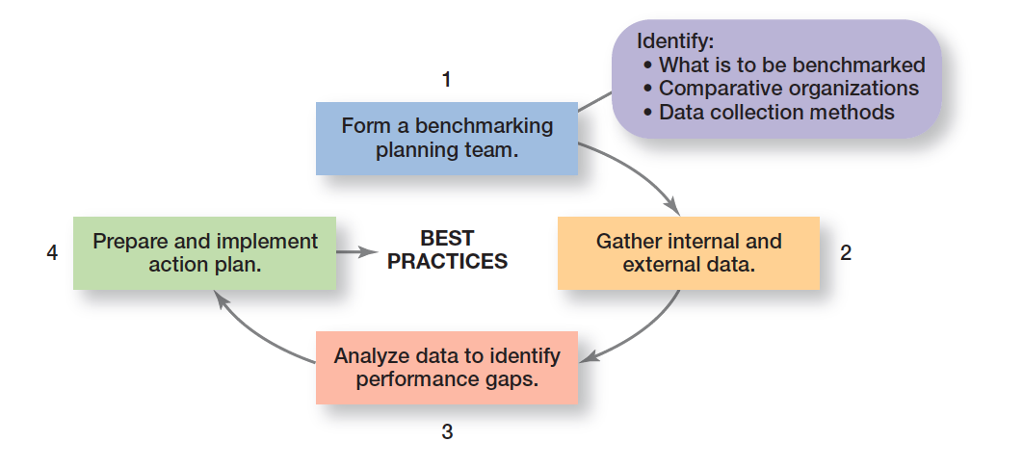
Exhibit PC-2 Steps In Benchmarking
Exhibit PC-2 illustrates the four steps typically used in benchmarking.
Notes:
Source: Based on “Aiming High: Competitive Benchmarking for Superior Performance,” by Y. K. Shetty, from Long Range Planning, vol. 26, no. 1, 1993, pp. 39–44.

Slide 8
Techniques for Allocating Resources
Resources: an organization’s assets—including nancial, physical, human, intangible, and structural/cultural—that are used to develop, manufacture, and deliver products to its customers
Notes:
Before managers can organize and lead as goals are implemented, they must have resources, the assets of the organization (financial, physical, human, and intangible).

Slide 9
Budgeting
Budget: a numerical plan for allocating resources to specific activities
Budgeting: the process of allocating resources to pay for designated future costs
Notes:
A budget is a numerical plan for allocating resources to specific activities. Managers typically prepare budgets for revenues, expenses, and large capital expenditures such as equipment. It’s not unusual, though, for budgets to be used for improving time, space, and use of material resources.
Budgeting is the process of allocating resources to pay for designated future costs. There are two common approaches to setting budgets: incremental budgeting and zero-base budgeting.

Slide 10
Two Common Budgeting Approaches
Incremental budgeting: process starting with the current budget from which managers decide whether they need additional resources and the justification for requesting it
Zero-based budgeting: Process starting with an established point of zero rather than using the current budget as the basis for adding, modifying, or subtracting resources
Notes:
A budget is a numerical plan for allocating resources to specific activities. Managers typically prepare budgets for revenues, expenses, and large capital expenditures such as equipment. It’s not unusual, though, for budgets to be used for improving time, space, and use of material resources.

Slide 11
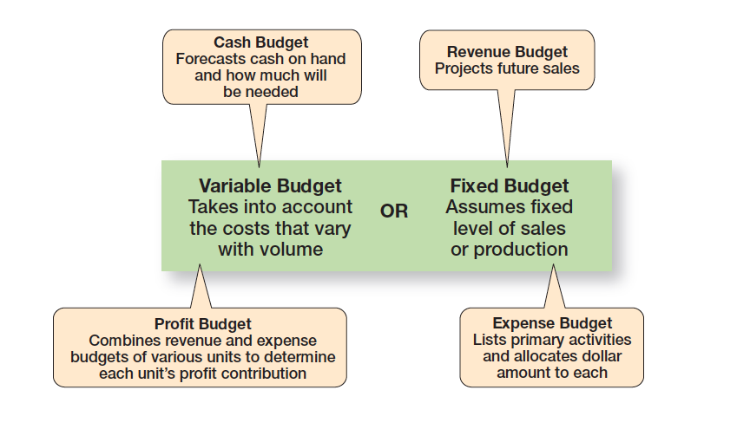
Exhibit PC-3 Types of Budgets
Exhibit PC-3 describes the different types of budgets that managers might use.
Notes:
Source: Based on Production and Operations Management, by R. S. Russell and B. W. Taylor III. Upper Saddle River, NJ: Prentice-Hall, Inc., 1966.

Slide 12
Exhibit PC-4 How to Improve Budgeting
Suggestion
Collaborate and communicate.
Be flexible.
Goals should drive budgets—budgets should not determine goals.
Coordinate budgeting throughout the organization.
Use budgeting/planning software when appropriate.
Remember that budgets are tools.
Remember that profits result from smart management, not because you budgeted for them.
Notes:
How can the budgeting process be improved? Exhibit PC-4 provides some suggestions.

Slide 13
Scheduling
Scheduling: detailing what activities have to be done, the order in which they are to be completed, who is to do each, and when they are to be completed
Gantt chart: a scheduling chart developed by Henry Gantt that shows actual and planned output over a period of time
Notes:
If you observed any group of supervisors or department managers for a few days, you would see them doing much the same—allocating resources by detailing what activities have to be done, the order in which they are to be completed, who is to do each, and when they are to be completed. These managers are scheduling. In this section, we’ll review some useful scheduling devices, including Gantt charts, load charts, and PERT network analysis.
The Gantt chart was developed during the early 1900s by Henry Gantt, an associate of Frederick Taylor, the scientific management expert. The idea behind a Gantt chart is simple. It’s essentially a bar graph with time on the horizontal axis and the activities to be scheduled on the vertical axis. The bars show output, both planned and actual, over a period of time. The Gantt chart visually shows when tasks are supposed to be done and compares those projections with the actual progress on each task. It’s a simple but important device that lets managers detail easily what has yet to be done to complete a job or project and to assess whether an activity is ahead of, behind, or on schedule.

Slide 14
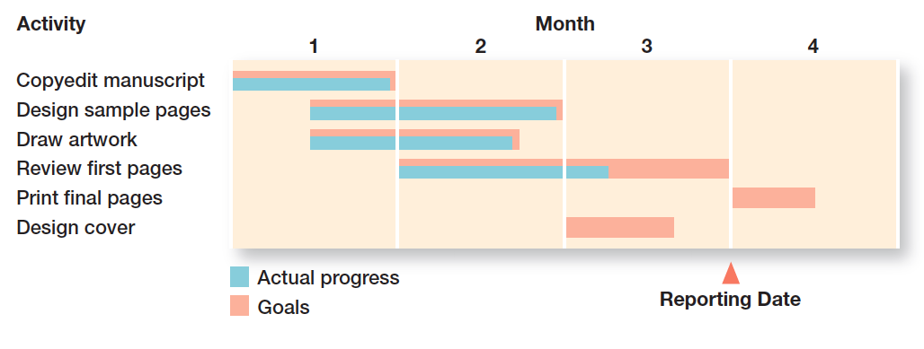
Exhibit PC-5 A Gantt Chart
Exhibit PC-5 depicts a simplified Gantt chart for book production.
Notes:
Exhibit PC-5 depicts a simplified Gantt chart for book production developed by a manager in a publishing company. Time is expressed in months across the top of the chart. The major work activities are listed down the left side. Planning involves deciding what activities need to be done to get the book finished, the order in which those activities need to be completed, and the time that should be allocated to each activity. Where a box sits within a time frame reflects its planned sequence. The shading represents actual progress. The chart also serves as a control tool because the manager can see deviations from the plan. In this example, both the design of the cover and the review of first pages are running behind schedule. Cover design is about three weeks behind (note that there has been no actual progress—shown by blue color line—as of the reporting date), and first pages review is about two weeks behind schedule (note that as of the report date, actual progress—shown by blue color line—is about six weeks, out of a goal of completing in two months). Given this information, the manager might need to take some action to either make up for the two lost weeks or to ensure that no further delays will occur. At this point, the manager can expect that the book will be published at least two weeks later than planned if no action is taken.

Slide 15
Load Charts
Load chart: a modified Gantt chart that schedules capacity by entire departments or specific resources
Notes:
A load chart is a modified Gantt chart. Instead of listing activities on the vertical axis, load charts list either entire departments or specific resources. This arrangement allows managers to plan and control capacity utilization. In other words, load charts schedule capacity by work areas.

Slide 16
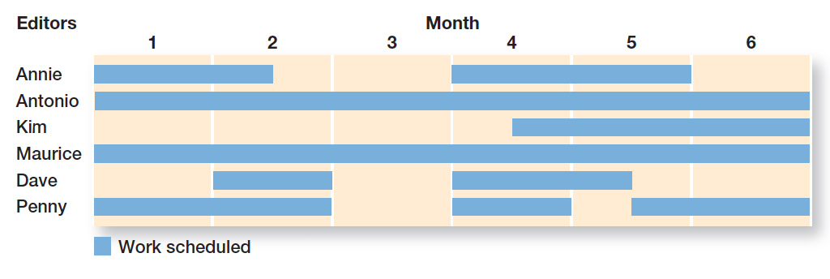
Exhibit PC-6 A Load Chart
Exhibit PC-6 shows a load chart for six production editors at the same publishing company.
Notes:
For example, Exhibit PC-6 shows a load chart for six production editors at the same publishing company. Each editor supervises the production and design of several books. By reviewing a load chart, the executive editor, who supervises the six production editors, can see who is free to take on a new book. If everyone is fully scheduled, the executive editor might decide not to accept any new projects, to accept new projects and delay others, to make the editors work overtime, or to employ more production editors. As this exhibit shows, only Antonio and Maurice are completely scheduled for the next six months. The other editors have some unassigned time and might be able to accept new projects or be available to help other editors who get behind.
Sample of a load chart. A bar graph with time on the horizontal axis and the departments or specific resources to be scheduled on the vertical axis. The bars show output, both planned and actual, over a period of time.

Slide 17
PERT Network Analysis (1 of 2)
PERT network: a flowchart diagram showing the sequence of activities needed to complete a project and the time or cost associated with each
Events: end points that represent the completion of major activities in a PERT network
Activities: the time or resources needed to progress from one event to another in a PERT network
Notes:
If you’re constructing a building, you obviously can’t start putting up the walls until the foundation is laid. How can managers schedule such a complex project? The program evaluation and review technique (PERT) is highly appropriate for such projects.
A PERT network is a flowchart diagram that depicts the sequence of activities needed to complete a project and the time or costs associated with each activity. With a PERT network, a manager must think through what has to be done, determine which events depend on one another, and identify potential trouble spots. PERT also makes it easy to compare the effects alternative actions might have on scheduling and costs.
To understand how to construct a PERT network, you need to know four terms. Events are end points that represent the completion of major activities. Activities represent the time or resources required to progress from one event to another.

Slide 18
PERT Network Analysis (2 of 2)
Slack time: the amount of time an individual activity can be delayed without delaying the whole project
Critical path: the longest sequence of activities in a PERT network
Notes:
Slack time is the amount of time an individual activity can be delayed without delaying the whole project. The critical path is the longest or most time-consuming sequence of events and activities in a PERT network. Any delay in completing events on this path would delay completion of the entire project. In other words, activities on the critical path have zero slack time.

Slide 19
Exhibit PC-7 Steps in Developing a PERT Network
Step
1. Identify every significant activity that must be achieved for a project to be completed. The accomplishment of each activity results in a set of events or outcomes.
2. Determine the order in which these events must be completed.
3. Diagram the ow of activities from start to finish, identifying each activity and its relationship to all other activities. Use circles to indicate events and arrows to represent activities. This results in a flowchart diagram called a PERT network.
4. Compute a time estimate for completing each activity. This is done with a weighted average that uses an optimistic time estimate (t_{o}) of how long the activity would take under ideal conditions, a most likely estimate (t_{m}) of the time the activity normally should take, and a pessimistic estimate (t_{p}) that represents the time that an activity should take under the worst possible conditions. The formula for calculating the expected time (t_{e}) is then t_{e} = (t_{o} +4t_{m} +t_{p})/6
5. Using the network diagram that contains time estimates for each activity, determine a schedule for the start and finish dates of each activity and for the entire project. Any delays that occur along the critical path require the most attention because they can delay the whole project.

Slide 20
Exhibit PC-8: Events and Activities in Constructing an Office Building
Event | Description | Expected Time (in weeks) | Preceding Event
A | Approve design and get permits | 10 | None
B | Dig subterranean garage | 6 | A
C | Erect frame and siding | 14 | B
D | Construct floor | 6 | C
E | Install windows | 3 | C
F | Put on roof | 3 | C
G | Install internal wiring | 5 | D, E, F
H | Install elevator | 5 | G
I | Put in floor covering and paneling | 4 | D
J | Put in doors and interior decorative trim | 3 | I, H
K | Turn over to building management group | 1 | J
Notes:
Exhibit PC-8 outlines the major events in the construction project and your estimate of the expected time to complete each.

Slide 21
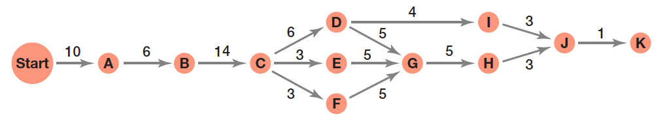
Exhibit PC-9: PERT Network for Constructing an Office Building
Exhibit PC-9 shows the actual PERT network based on the data in Exhibit PC-8.
Notes:
Exhibit PC-9 shows the actual PERT network based on the data in Exhibit PC-8. You’ve also calculated the length
of time that each path of activities will take:
A-B-C-D-I-J-K (44 weeks)
A-B-C-D-G-H-J-K (50 weeks)
A-B-C-E-G-H-J-K (47 weeks)
A-B-C-F-G-H-J-K (47 weeks)
Your PERT network shows that if everything goes as planned, the total project completion time will be 50 weeks. This is calculated by tracing the project’s critical path (the longest sequence of activities), A-B-C-D-G-H-J-K, and adding up the times.

Slide 22
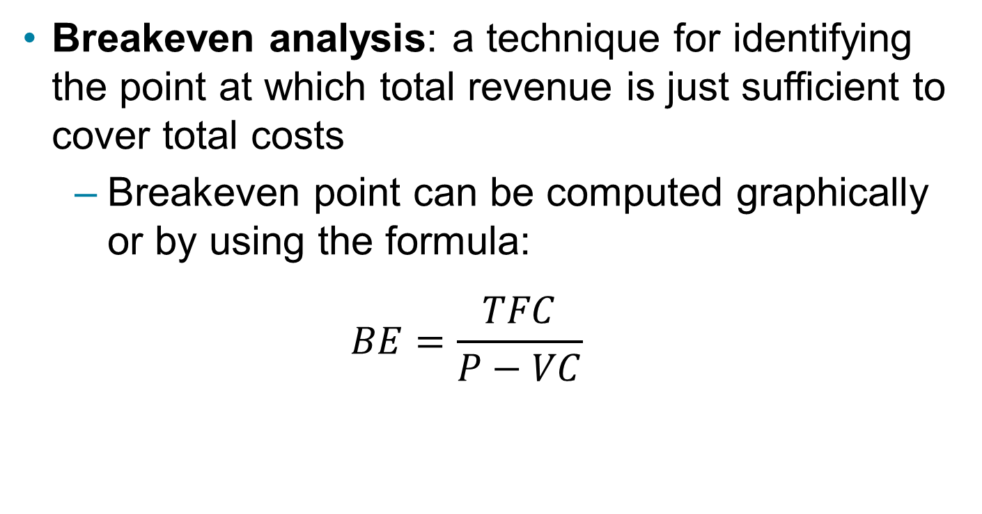
Breakeven Analysis
Breakeven analysis: a technique for identifying the point at which total revenue is just sufficient to cover total costs
Breakeven point can be computed graphically or by using the formula:
$$BE=\frac{TFC}{P−VC}$$
Notes:
Breakeven analysis is a widely used resource-allocation technique to help managers determine breakeven point. Breakeven analysis is a simple calculation, yet it’s valuable to managers because it points out the relationship between revenues, costs, and profits. To compute breakeven point (BE), a manager needs to know the unit price of the product being sold (P), the variable cost per unit (VC), and total fixed costs (TFC). An organization breaks even when its total revenue is just enough to equal its total costs. But total cost has two parts: fixed and variable. Fixed costs are expenses that do not change regardless of volume. Examples include insurance premiums, rent, and property taxes. Variable costs change in proportion to output and include raw materials, labor costs, and energy costs.

Slide 23
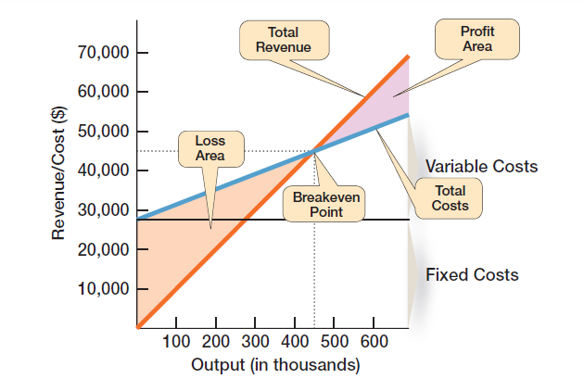
Exhibit PC-10 Breakeven Analysis
Exhibit PC-10 graphically represents the breakeven point for a scenario.
Notes:
Assume that Randy’s Photocopying Service charges $0.10 per photocopy. If fixed costs are $27,000 a year and variable costs are $0.04 per copy, Randy can compute his breakeven point as follows: $27,000 ÷ ($0.10 – $0.04) = 450,000 copies, or when annual revenues are $45,000 (450,000 copies × $0.10). This same relationship is shown graphically in Exhibit PC-10.

Slide 24
Linear Programming
Linear programming: a mathematical technique that solves resource-allocation problems
Notes:
Linear programming is a mathematical technique that solves resource-allocation problems.

Slide 25
Exhibit PC-11: Production Data for Cinnamon-Scented Products
Department | Number of Hours Required (per unit) Potpourri Bags | Number of Hours Required (per unit) Scented Candle | Monthly Production Capacity (in hours)
Manufacturing | 2 | 4 | 1200
Assembly | 2 | 2 | 900
Profit per unit | $10 | $18 | blank
Notes:
The figure shows production data for the scenario involving Maria’s business.

Slide 26
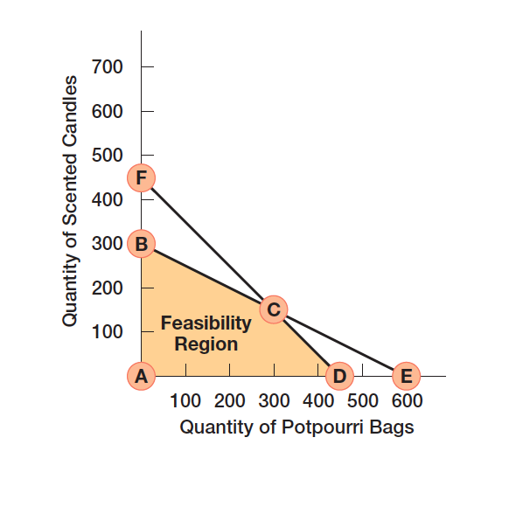
Exhibit PC-12: Graphical Solution to Linear Programming Problem
Exhibit PC-12 shows shows the graphical solution in Maria’s scenario.
Notes:
At point A, profits would be 0 (no production of either potpourri bags or scented candles). At point B, profits would be $5,400 (300 scented candles * $18 profit and 0 potpourri bags produced = $5,400). At point D, profits would be $4,500 (450 potpourri bags produced * $10 profit and 0 scented candles produced = $4,500). At point C, however, profits would be $5,700 (150 scented candles produced * $18 profit and 300 potpourri bags produced * $10 profit = $5,700).

Slide 27
Project Management
Project: a one-time-only set of activities that has a definite beginning and ending point in time
Project management: the task of getting a project’s activities done on time, within budget, and according to specifications
Notes:
A project is a one-time-only set of activities that has a definite beginning and ending point in time. Projects vary in size and scope—from Boston’s “big dig” downtown traffic tunnel to a sorority’s holiday formal. Project management is the task of getting a project’s activities done on time, within budget, and according to specifications.

Slide 28
Exhibit PC-13: Project Planning Process
The essential features of the project planning process are shown in Exhibit PC-13.
Notes:
Source: Based on Production and Operations Management, by R. S. Russell and B. W. Taylor III. Upper Saddle River, NJ: Prentice-Hall, 1996.

Slide 29
Scenario Planning
Scenario: a consistent view of what the future is likely to be
Notes:
A scenario is a consistent view of what the future is likely to be. Developing scenarios can also be described as contingency planning; that is, if this event happens, then we need to take these actions.

Slide 30

Copyright

